Slide 1
Implementation of GitHub into research workflow
Alessandro Sparacio
LIP/PC2S

Slide 2


GitHub: What are we talking about?
Objective:
Knowing GitHub
Understanding how it can be implemented in your workflow
Exploring the benefits of using Github

Slide 3
GitHub: What are we talking about?
Version control system
Social networks for developers

Slide 4
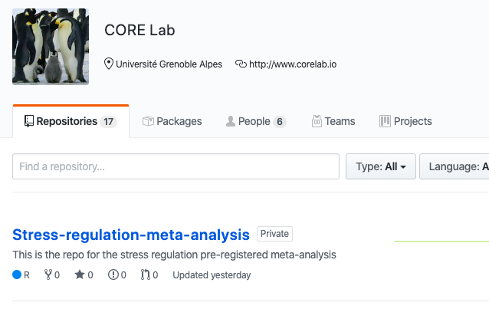
GitHub: What are we talking about?
Version control system

Slide 5
GitHub: What are we talking about?
Why use GitHub?
It makes it easier to work with other people:
No email or onedrive folder to send new scripts
It will be possible to work on the same file at the same time, with more people
Git will combine the changes automatically and it will display all the ambiguites and conflicts

Slide 6
GitHub: What are we talking about?
Why use GitHub?
It is easier to spot mistakes:
It is possible to see exactly small variations made to the script, preventing big wasting of time

Slide 7
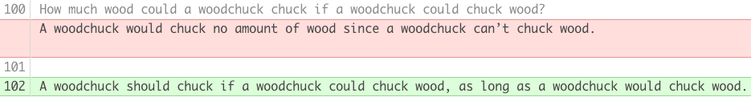
GitHub: What are we talking about?
Let’s see into detail
The background color nudges you to the changes that have been made:
Green (for text that has been added)
Red (for text that has been removed)

Slide 8

GitHub: What are we talking about?
… But, someone might say…
I already use OSF, why should I use GitHub?

Slide 9
GitHub: What are we talking about?
… Because GitHub allow you to do the same (and more) things In a way, that is easier and faster
It is also possibile to integrate GitHub into your project in OSF

Slide 10
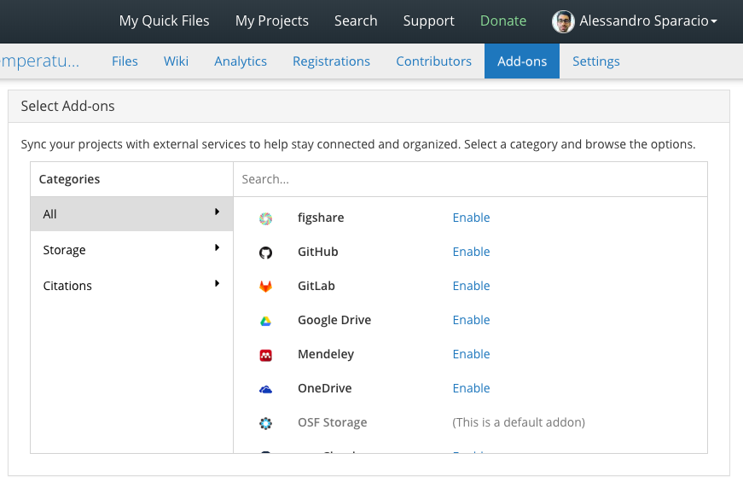
GitHub: What are we talking about?

Slide 11
GitHub: What are we talking about?
How to start?
Step 1) Install Git & create GitHub account
Git is an open-source tool developers install locally to manage source code
GitHub is an online service to which developers who use Git can connect and upload or download resources

Slide 12
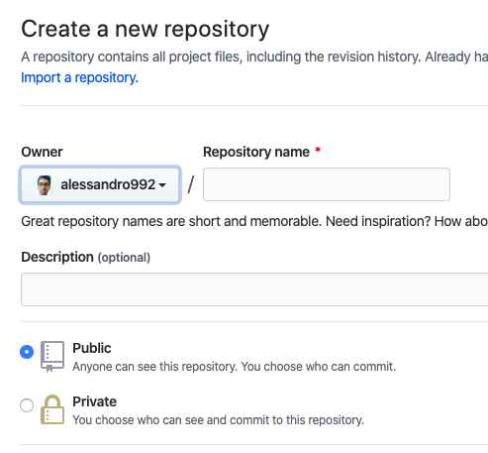
GitHub: What are we talking about?
How to start?
Step 2) Create a repository on GitHub

Slide 13
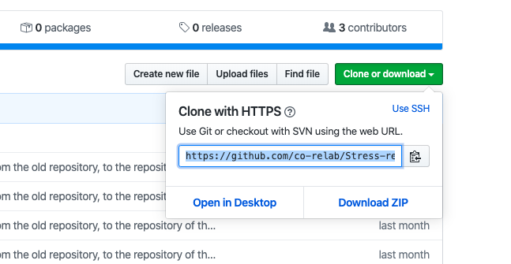
GitHub: What are we talking about?
How to start with GitHub?
Step 3) Clone a repository from GitHub

Slide 14
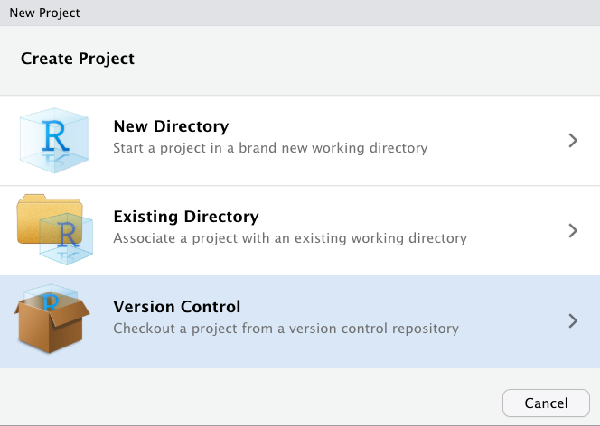
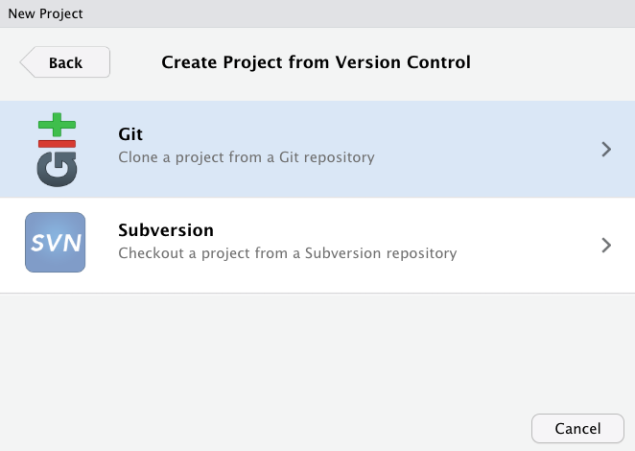
GitHub: What are we talking about?
How to start with GitHub?
Step 3) Clone a repository from GitHub

Slide 15
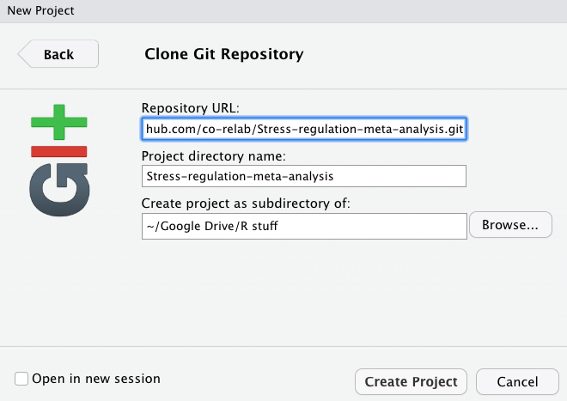
GitHub: What are we talking about?
How to start with GitHub?
Step 3) Clone a repository from GitHub

Slide 16
GitHub: What are we talking about?
How to use GitHub?
Commit --- It allows you to take a snapshot of the desired file

Slide 17
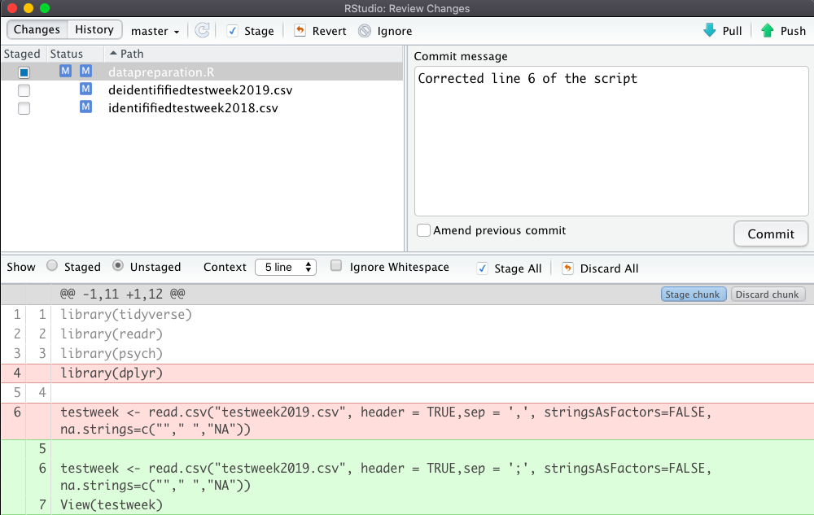
GitHub: What are we talking about?
How to do a commit:
1) You select which files will be included in the next commit
2) You provide a comment of the changes you want to commit
3) A changeset display which shows files changed, added or removed

Slide 18
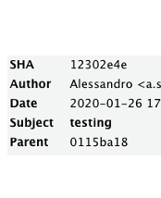

GitHub: What are we talking about?
What are the elements of a commit?
1
SHA (secure has algorithm)
2
Author
3
Date
4
Subject
5
Parent
Which is the previous commit The initial commit doesn’t have a parent)

Slide 19
GitHub: What are we talking about?
What should you put in a commit:
Changes related to a single issue you have solved. For the following issue it is good practice to do a separate commit
The commit message:
Enough details which can explain what was done.
It should provide a high-level summary which focuses on why you have changed the script

Slide 20

GitHub: What are we talking about?
Clear messages will help not only your collaborators but also future yourself

Slide 21
GitHub: What are we talking about?
Pushing to GitHub
To push the code to GitHub:
Save a file and commit
Push the changes to GitHub by clicking Push
Refresh your GitHub page and see how it is changed
Usually you want to push after that you have done some commits.

Slide 22
GitHub: What are we talking about?
How to do a push:
You push your
changes to your GitHub repository

Slide 23
GitHub: What are we talking about?
How to do a pull:
If one of your collaborator want to see the changes, he has to pull them from the GitHub repository

Slide 24
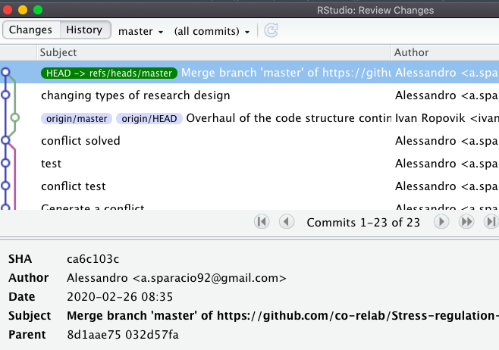
GitHub: What are we talking about?
Git allows you to see a history of the changes made to your script

Slide 25
GitHub: What are we talking about?
Clone, push & pull in a nutshell
GitHub repo
clone
Olivier

Slide 26
GitHub: What are we talking about?
Clone, push & pull in a nutshell
GitHub repo
Olivier
clone
Patrick

Slide 27
GitHub: What are we talking about?
Clone, push & pull in a nutshell
GitHub repo
push
Olivier
Patrick

Slide 28
GitHub: What are we talking about?
Clone, push & pull in a nutshell
GitHub repo
Olivier
pull
Patrick

Slide 29

GitHub: What are we talking about?
A use case: Working with a collaborator
Script of Testweek 2019/2020

Slide 30
GitHub: What are we talking about?
Problem: Debug the script of the testweek
Correct the script
Spot the mistakes in the script

Slide 31


GitHub: What are we talking about?
Without GitHub
1
2
3
4
5
Patrick has to download the uncorrected script and spot the mistakes
Patrick has to signal the mistakes in the script with comments and send it to Olivier
Olivier has to download the uncorrected script, make changes and put comments in order to make Patrick aware of the changes
Olivier has to send via email a new version of the script to Patrick
Patrick can see the changes looking at the comments in the corrected script of Olivier

Slide 32
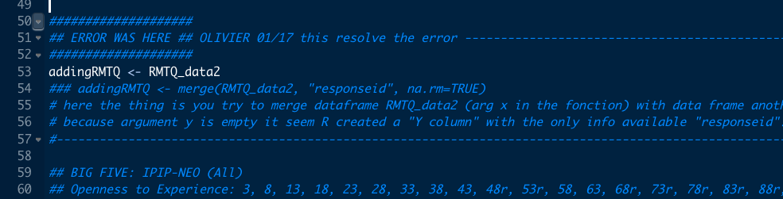
GitHub: What are we talking about?

Slide 33
GitHub: What are we talking about?
With GitHub
1
2
3
4
5
1) Patrick has to download the uncorrected script (from GitHub) and spot the mistakes
Patrick has to signal the mistakes in the script with comments (but GitHub will make it easy to see them)
Olivier has to download the uncorrected script (from GitHub), he has to make changes and finally he has to push the corrected script to GitHub (no comments are needed)
Patrick has to pull the new corrected script from GitHub (no mail is needed) to see the changes
Bonus: They can work at the script at the same time!

Slide 34
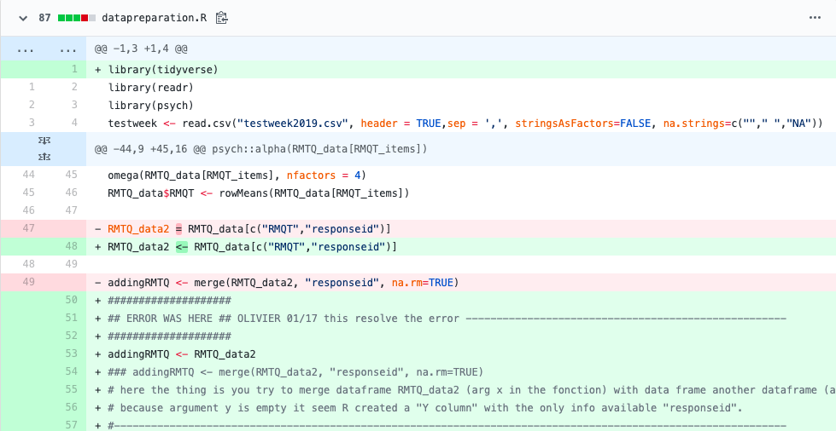
GitHub: What are we talking about?

Slide 35
GitHub: What are we talking about?
Working with collaborators:
Push to send your changes to GitHub
Your collaborators will pull the changes from GitHub to their local repository
N.B. You can push if you have retrieved the most updated version of the file with a pull

Slide 36
GitHub: What are we talking about?
Working at the SAME TIME with collaborators:
When you pull, Git first fetches the modifications that have been done and then merges them with changes that you have done.
If they refers to different part of the code, there will not be any problems
If they are related to the same line of code, you have to resolve the merge conflict yourself

Slide 37
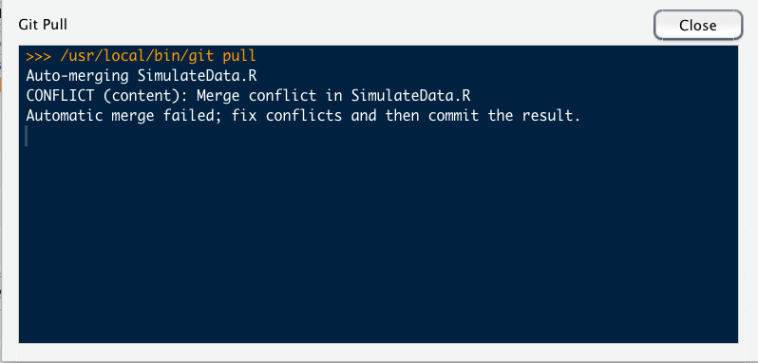
GitHub: What are we talking about?
How to merge a conflict:

Slide 38
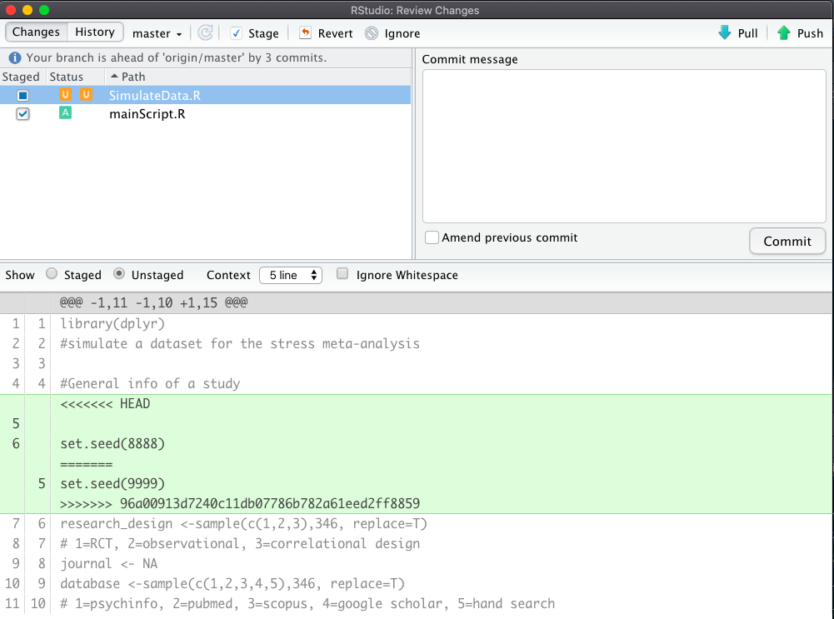
GitHub: What are we talking about?
How to merge a conflict:
The conflict is displayed in the same commit interface

Slide 39
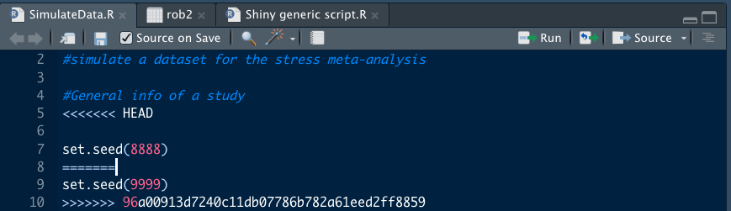
GitHub: What are we talking about?
How to merge a conflict:
The conflict can be solved by modifying directly the script (by removing one line of code or the other)

Slide 40
GitHub: What are we talking about?
Branches:
When you want to make big changes to your script without having to disturb the main stream of development.
The default branch is called master. If you synchronise the code to GitHub you will have a branch called origin/master.
Branches are useful when you want to break away from the main stream of development

Slide 41
GitHub: What are we talking about?
Branches:
When you have done working on a branch, you can either merge it back into the master or you can delete it

Slide 42
GitHub: What are we talking about?
Conclusions
Advantages for using GitHub
No need to save more version of the same file
Easy to spot mistakes
Allow to work with others at the same time
Need to learn a few basic actions only (e.g. commit, push & pull)
Future you, will thank you

Slide 43
GitHub: What are we talking about?
Conclusions
Disadvantages for using GitHub
User interface is not really user friendly
Your collaborators should have GitHub too, if you want to work with them using GitHub

Slide 44





Co-Regulation (CORE) Lab
La pêche!
Thank you for listening
https://corelab.io

Slide 45
Co-Regulation (CORE) Lab
Thank you for listening
https://corelab.io

